Slide 1

Welcome To Java Green
M1-D1
Participate! The more engagement the better!
You are NEVER interrupting me!

Slide 2


TODAY’S AGENDA
Introductions
Expectations and Best Practices
Lunch
The File System
Bash Shell & Working With Files
*** Machine Setup ***
Git & Source Code Control

Slide 3
Class Intro
What did you do before Tech Elevator?
What experience do you have with programming (if any)?
Do you have any Hobbies or Fun Facts?

Slide 4
Week 1 at a glance…

Slide 5
| WEEK 1
Technical Instruction Only - Pathway has additional requirements
Intro To Tools / Git
Variables and Datatypes
Expressions and Branching
Loops and Arrays
Command Line Programs
Monday
Tuesday
Wednesday
Thursday
Friday
All lectures going forward start at 9:00. Be in the building by 8:45, in class by 8:55. Pull lecture code when you arrive

Slide 6
EXPECTATIONS & BEST PRACTICES

Slide 7

Slack is our primary communication tool
Etiquette
Set name to First and Last name and add a profile picture of yourself
When returning to a channel, catch up on all messages since the last time you were there.
Use status to indicate when you are working or away
When showing as available, respond in a timely manner (15-20 mins), even if it is just to say you saw it and will answer later.
Emoji messages that contain information or directions to indicate you’ve seen them.
Abilities
Use Huddles for screen sharing and voice chat

Slide 8

|Daily Workflow
Before each lecture
Complete the Reading and Tutorial in Bootcamp OS
Complete the Quiz (Required)
Lecture
Starts at 9am. Be on time.
Ends when we complete that days objectives
After Lecture
Exercises
Pathway
Collaboration

Slide 9

| CLASSROOM INTERACTION
Please ask questions
Please ask me to slow down or go back
Fun, but professional
Stand up if you get tired
Keep the classroom clean
Watch noise levels during/after class.

Slide 10

THERE ARE 40’ish HOURS SCHEDULED PER WEEK
Monday - Friday 9:00 - 4:30
Notes:
7.5 hours a day x 5 days a week
9:00am - 4:30pm
1 hour lunch
Lecture in morning, lab in afternoon
24 x 7 access
Key card gets you in the building

Slide 11

40 HOUR WEEKS ARE NOT REALITY
The average student spends 45 -70+ hours per week on self-study, exercises, pathways, and pair projects.
Notes:
7.5 hours a day x 5 days a week
9:00am - 4:30pm
1 hour lunch
Lecture in morning, lab in afternoon
24 x 7 access
Key card gets you in the building

Slide 12
| DUE DATES
Exercises are distributed daily. You submit them by pushing your code back to GitLab (git.techelevator.com).
EXERCISES GIVEN... | ARE DUE...
Monday | Wednesday 9 AM
Tuesday | Thursday 9 AM
Wednesday | Friday 9 AM
Thursday | Monday 9 AM
Friday | Tuesday 9 AM
Notes:
We begin scoring exercises on the 2nd business day after they have been assigned.

Slide 13
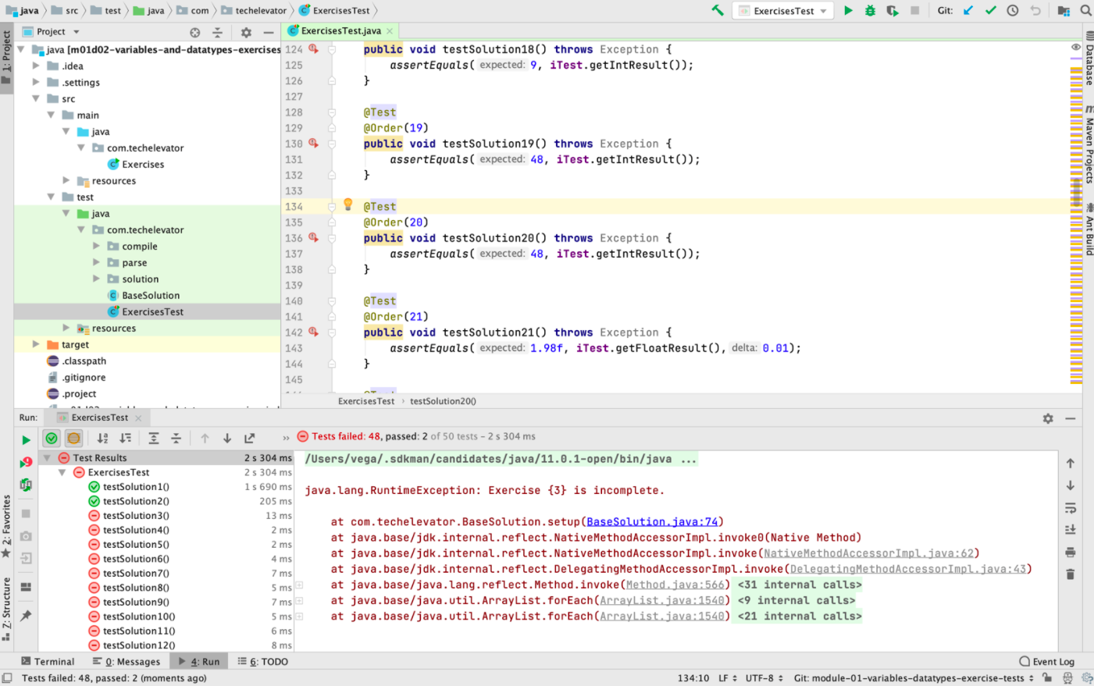
Exercise Scores
Solutions are scored on a 3-point scale.
0 | Does not compile or no attempt made.
1 | 25% of the tests pass.
2 | 50% of the tests pass.
3 | 90% of the tests pass.
Your module score must be 2.0 or higher to pass each Module or you are withdrawn.
Notes:
You will be assigned exercises nearly every day during the cohort. These exercises are generally scored two business days later. We use these exercises at the primary way to track your progress during the program, and your scores on those exercises determine your academic standing in the bootcamp.
We score exercises using a 3-point scale.
Here you'll see that any code submitted which does not compile or has no attempt made receives a zero. To get a one (1), you must have 25% of the provided tests pass, 50% gets you a two (2), and 90% get you a three (3).
We consider a two (2.0) or higher a passing score.
You'll notice that the gap between two and three can be pretty significant. You may "want" to get all threes on each topic. That's fine, but consider moving on to the next topic if you've spent a considerable amount of time on one exercise and there's still more work to complete for the week.
IMPORTANT TO NOTE: Full-Time Academic Grading Policy (School Catalog)
“The program is administered using a pass/fail grading system, and consecutive successful completion of all four (4) Modules is required to complete the course and graduate. For a student to pass each of the first three (3) Modules, the following requirements must be met:
All units in the Module must be completed in Bootcamp OS, and
The average score on Module exercises must be 2.0 points or higher.
If a student fails to meet these requirements for any of the first three (3) Modules, they withdrawn from the Program.
In order to successfully complete Module 4, a student must significantly contribute to the completion of a Final Capstone project.”
SAMPLE TRANSITION STATEMENT: “That’s how your exercises will be graded, but you may be wondering, ‘What happens if I fall behind?’”

Slide 14
Regrade & Make-up Policy
For an exercise to be regraded:
Resubmit it through Bootcamp OS. An instructor will post the score once they review it.
All resubmits for a module must be submitted by the end of the Module.
If you receive…
1 or 2 points | Complete/resubmit to bring your score up to a max of 3 points.
0 points | Complete/resubmit to bring your score up to a max of 2 points. You can only do this twice per module
Notes:
If you fall behind or receive less than two points, or miss class, you’ll have options to resubmit exercises.
Following are the notes for Tech Elevator’s Regrade Policy and Make-up Policy. They are documented for further detail in the school catalog.
Regrade Policy
Exercises that receive a “0” or “1” may be submitted for regrading: up to two “0”s per Module and no limit on the number of “1”s per Module. The maximum score you can receive on a regrade is 2 points.
Exercises can only be resubmitted once, and the points received on a regrade are final. They also must be submitted by the end of the Module in which they are assigned, and you must inform your instructor in advance that you are resubmitting a specific exercise.
Make-up Policy
It is your responsibility to ask your instructor about any assigned work that may have been missed during an absence or missed due to special circumstances that prevented you from submitting the exercise(s).
To be eligible to earn full credit (maximum of 3.0 points) for exercises covered under this policy, the instructor must grant permission for those exercises to be submitted, and the exercises must be submitted by a deadline extension agreed upon by your instructor.
IMPORTANT: Module 1 & Module 2 Capstone Participation
“To be eligible to participate in a Module’s capstone project, a student’s average score for that Module must be 2.0 or higher at the time instructors assign capstone teams. “
If your average score is below a 2.0 at the time that your instructors are assigning capstone teams, you will not be able to participate in that project. Instead, you will be afforded the time to resubmit exercises to get to a passing grade.
If you do so before the end of the capstone project, your instructor may assign you to a team or may assign a different individual project.
If you do not resubmit exercises or your grades on your resubmissions don’t result in a passing grade, you’ll be administratively withdrawn from the program.
Refer students to the school catalog for the details.
SAMPLE TRANSITION STATEMENT: “Now that we’ve covered important information about how your work will be graded, it is also important to talk about how you approach completing your exercises…”

Slide 15
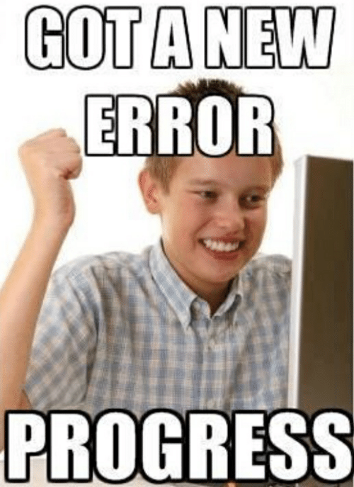
IMPOSTOR SYNDROME
You will spend more time with code that DOES NOT work, than code that DOES work. You will spend more time NOT understanding things, than understanding things. This is NORMAL!

Slide 16
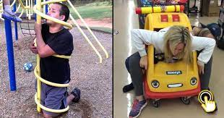

YOU WILL GET STUCK
A LOT

Slide 17

DO NOT SUFFER IN SILENCE
“One of the biggest defects in life is the inability to ask for help” - Robert Kiyosaki

Slide 18
| What to do when you are stuck
Revisit BootcampOS, tutorials, and sample code from lectures.
Classmates - it is OK to talk through the approach of a problem, but do not share code. You must understand the final code and turn in your own work.
Use Online resources like Google / Stack Overflow, etc. Not to copy answers, but to fill in missing pieces of your learning, or look up syntax.
Ask an instructor for help.
Slack - Post your question in the cbus-23-homework-help channel. Use after hours or when instructors are unavailable, emoji reaction with golden ticket

Slide 19
| Getting help after hours
“Official” staff hours: Monday-Friday 9 am-4:45pm.
After working hours, use golden ticket in HW help slack channel. Help each other out, but do not share code.
The best way to get help is to be here during the afternoons. Don’t expect quick responses after hours, if at all. We do our best to help. We can do it better when you are here.

Slide 20
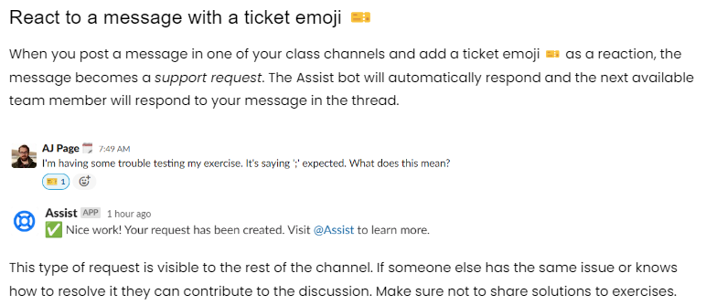
Help Desk| Getting help after hours

Slide 21
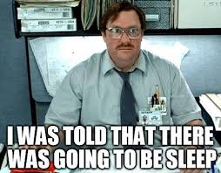
Student Best Practices
Get proper sleep.
Follow the 12 O’clock rule.
Sleep deprivation significantly impairs focus, attention, mood, health, and memory retention.
It can take days/weeks to recover.

Slide 22

Treat this as a job, not a class.
Most hiring managers/recruiters will ask us to rate you on FIVE key things at a minimum:
Were they a good teammate and easy to work with?
Did they participate in class discussions / projects?
How was their attendance and punctuality?
Were assignments turned in on time and was work high quality?
How did they handle the technical curriculum from understanding concepts to applying them.

Slide 23
Getting “Hired” As A Programmer
This usually is a several step process (varies by company): 1. Pre-screen interview (15-30 minute interview) 2. HR and/or behavioral interview (30-60 minutes) 3. Technical Interview (60-120 minutes - deep dive) 4. Coding assessment / Take home assignment / Reference Checks 5. Final interview
Grades only matter to get you to graduation. You need to do what it takes to get proficient so you can WIN the interview.

Slide 24

Practice! Practice! Practice!
(And then…. practice some more)
You get out of this, what you put in it. If you do the bare minimum you will struggle in class and most likely getting a job.

Slide 25
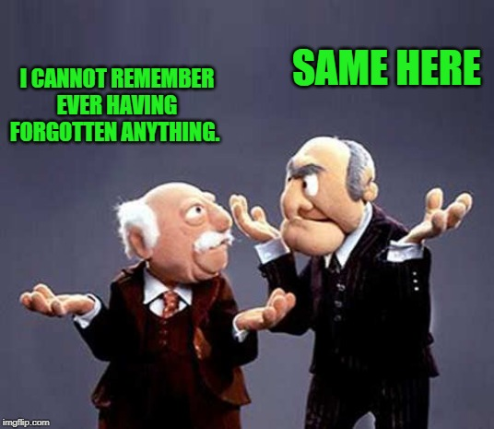
Do not try to memorize everything
Know the concepts then be proficient at the fundamental aspects of code (loops, conditional statements, etc) Use Intellisense to help with ‘method calls’
Organization is Key! Organize reference material for quick access (Cheat sheets, create a G-Drive folder, etc)

Slide 26

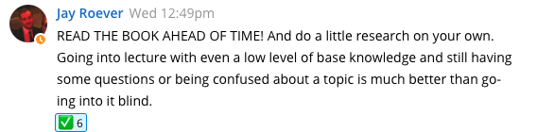
Bootcamp OS reading and tutorials
Read the material and do the tutorials before lecture. You don’t have to master the material in advance but you should have a basic understanding of what we will be covering.

Slide 27

YouTube and Books/Articles can be great, but….
Use Caution: Often only contains bits and pieces of what you need or is outdated.
Always ‘searching or watching’ can be a sign of avoidance or resistance.
Time management is a must. Don’t sit and spin your wheels being ‘busy’. You must be productive.

Slide 28
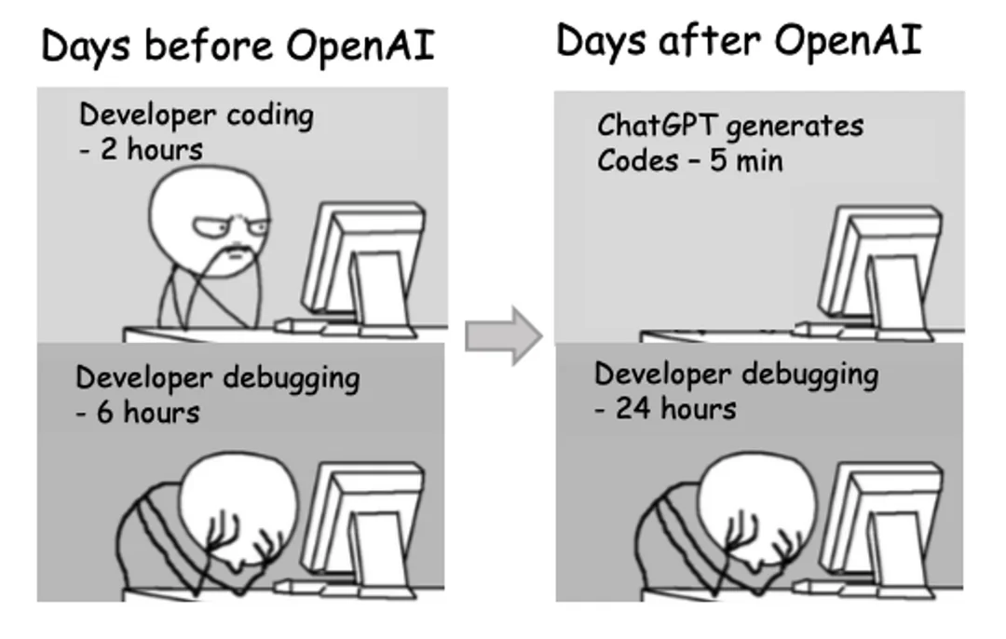
ChatGPT
When learning to program DO NOT use ChatGPT to do exercises. But you CAN ask it to explain what a piece of code is doing OR
To explain a concept

Slide 29

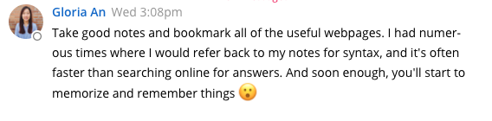
Two Notebooks (Optional)
One for taking notes during lecture
One for ‘potential’ interview questions

Slide 30
What Has Worked Well For Past Classes
Learn from each other, share a tip, share interesting things you learn. Don’t be a passive learner. Don’t try fly under the radar. Engage!
Create weekend study groups (2-3 people max) for interviewing practice. Rotate group members.
Get to know each other and students in other classes.

Slide 31
Have a FUN, positive attitude. Avoid whining or negativity. Laugh off the overwhelm.
Take care of yourself mentally and physically. Eat healthy, exercise and take small breaks.
If you need to talk, ever, PLEASE see me or someone on the team. We have seen it all and can help get you on track.
No matter how hard it seems. You got this!

Slide 32
Questions?

